Slide 1
Activity 2: PROPERTIES AND APPLICATIOON OF 2D FOURIER TRANSFORM PART 2
Genesis Vertudez – 202003099
App Physics 157 - Computational Analysis and Modeling in Physics
Submitted to Dr. Maricor Soriano; Mx. Rene Principe Jr.

Slide 2
OBJECTIVES
Use Fourier transform to manipulate images
Convolve images with patterns to apply it to them
Convolve images with filters to improve them
Use Fourier transform to locate certain patterns in images

Slide 3
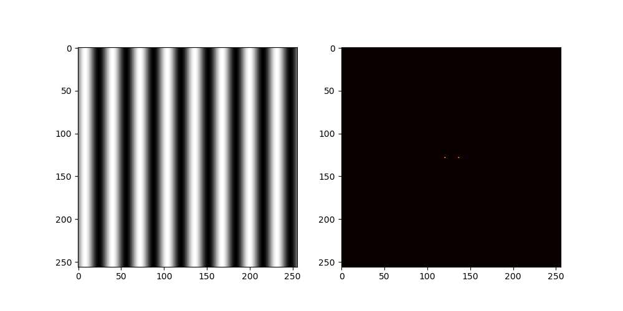

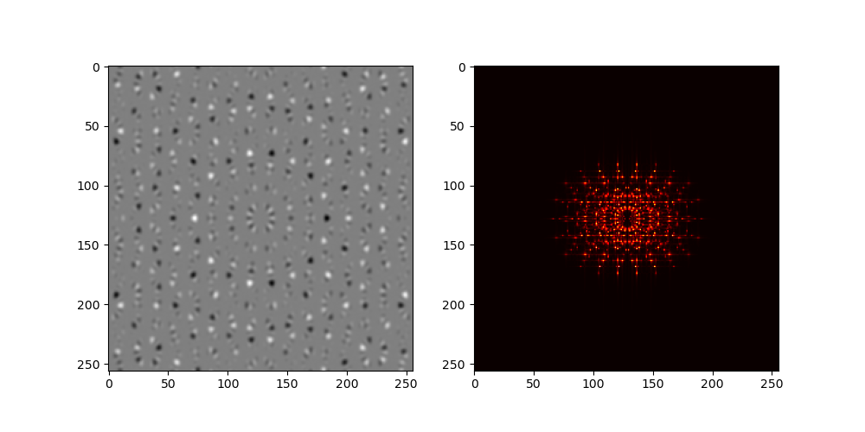
ROTATION PROPERTIES OF FT
The Fourier transform of a sinusoid are two Dirac delta functions, which are represented by a pixel, separated by the magnitude of the frequency, as seen in the first picture on the left.
Interestingly, rotating the sinusoid also rotates its Fourier transform as seen in the second picture on the left.
The third picture below shows products of sinusoids rotated at different angles. The Fourier transform of this image is then a beautiful sum of rotated Dirac deltas.
Codes and files: https://github.com/genvert/AP_157_FX-2_Vertudez/tree/main/Activity%202%20Part%202

Slide 4
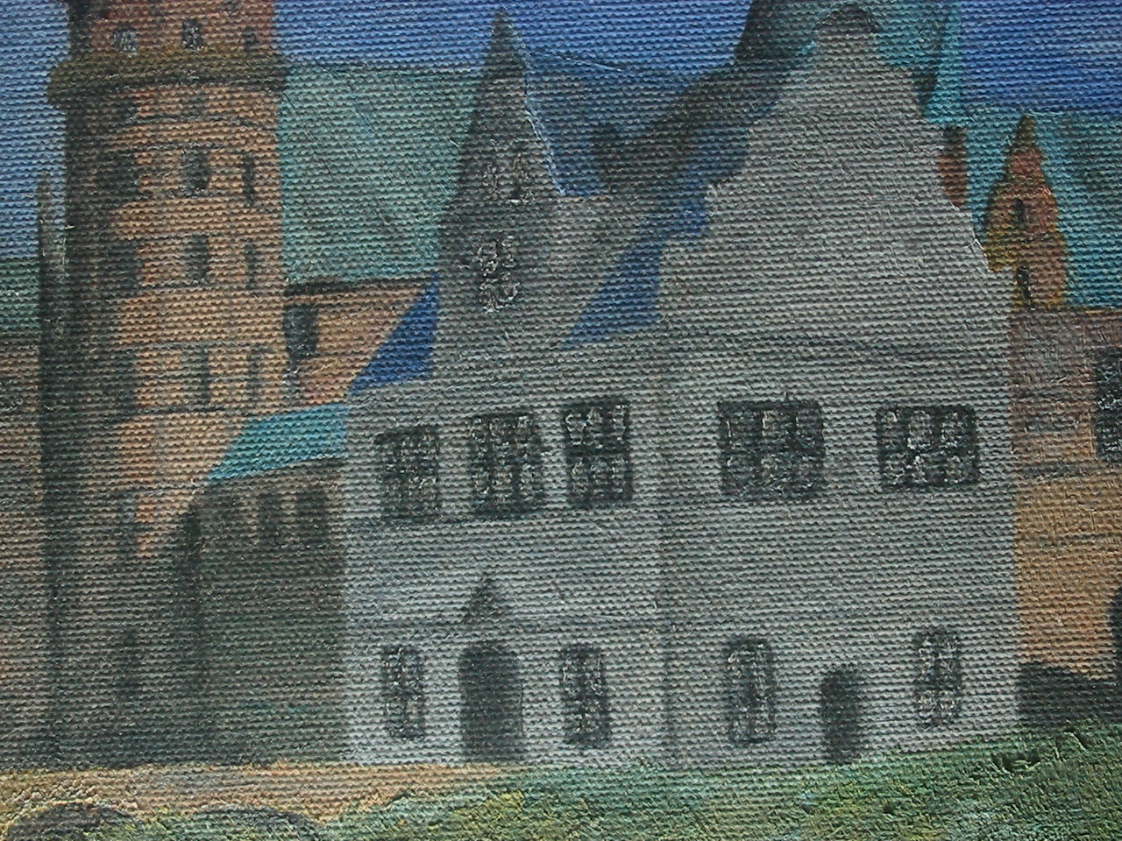
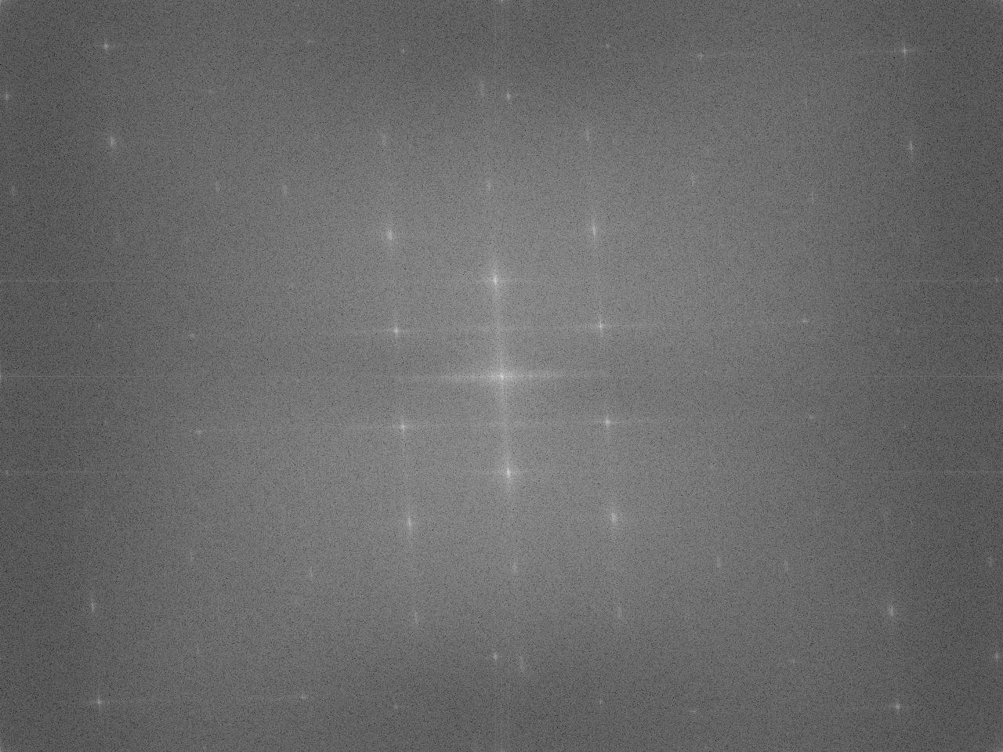
FILTERING IN FOURIER SPACE
Codes and files: https://github.com/genvert/AP_157_FX-2_Vertudez/tree/main/Activity%202%20Part%202

Slide 5

FILTERING IN FOURIER SPACE
Codes and files: https://github.com/genvert/AP_157_FX-2_Vertudez/tree/main/Activity%202%20Part%202

Slide 6
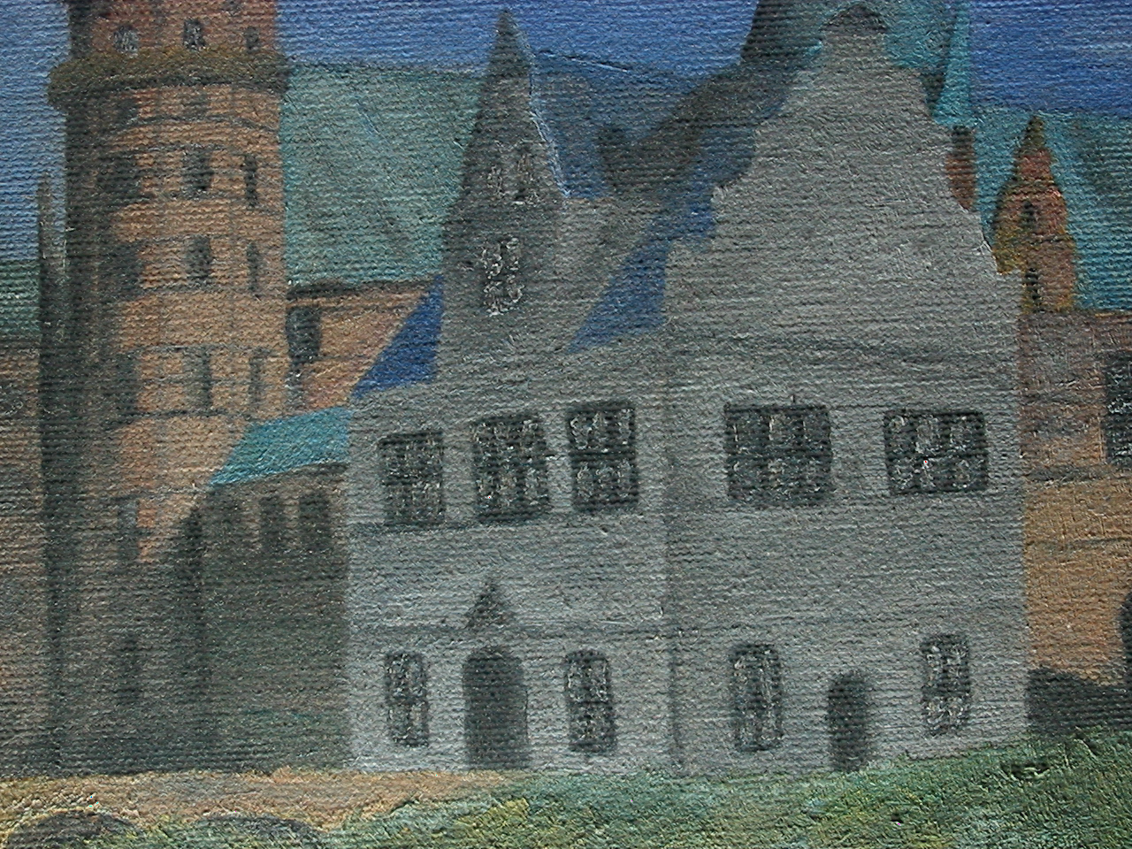
FILTERING IN FOURIER SPACE
Codes and files: https://github.com/genvert/AP_157_FX-2_Vertudez/tree/main/Activity%202%20Part%202

Slide 7

FILTERING IN FOURIER SPACE
Codes and files: https://github.com/genvert/AP_157_FX-2_Vertudez/tree/main/Activity%202%20Part%202

Slide 8

FILTERING IN FOURIER SPACE
Codes and files: https://github.com/genvert/AP_157_FX-2_Vertudez/tree/main/Activity%202%20Part%202

Slide 9
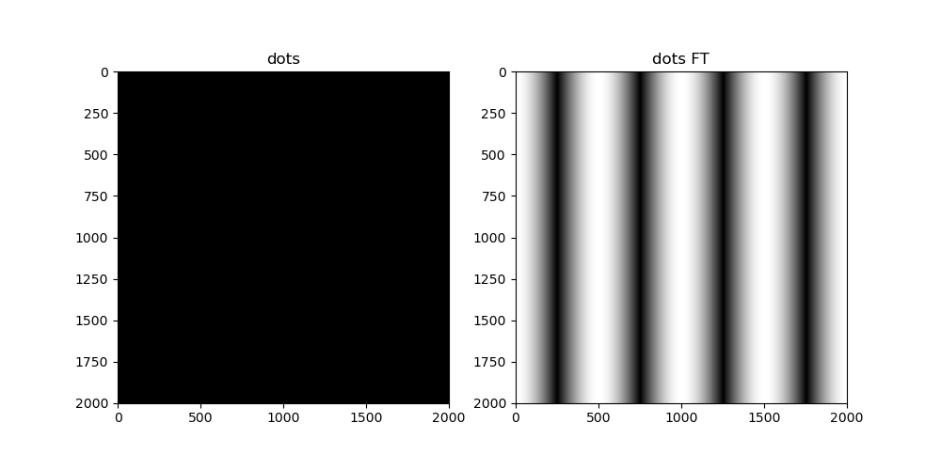
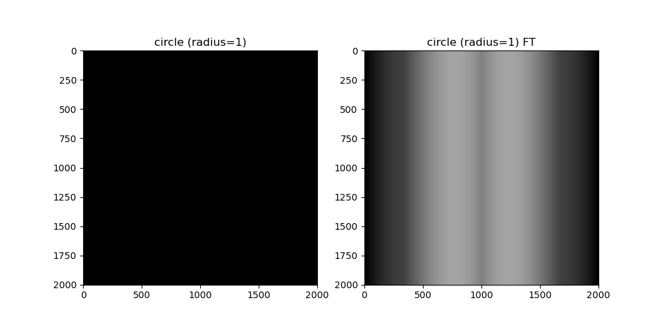
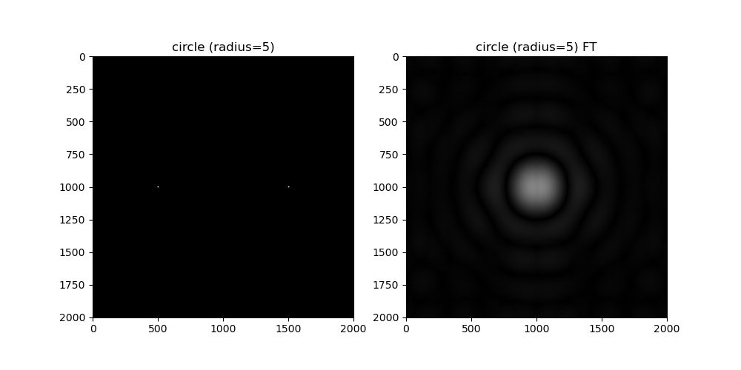
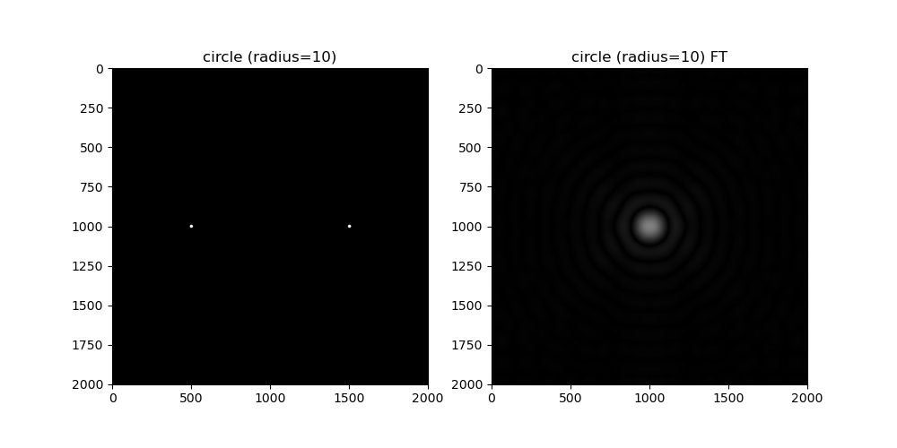
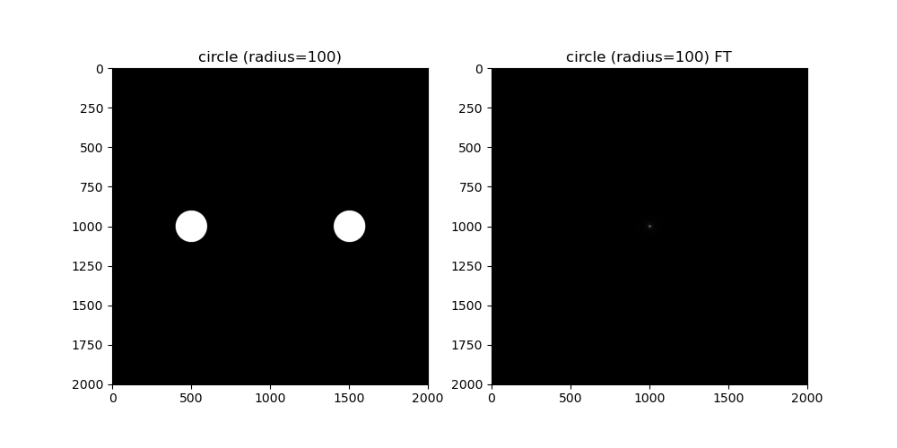
CONVOLUTION THEOREM REDUX
Codes and files: https://github.com/genvert/AP_157_FX-2_Vertudez/tree/main/Activity%202%20Part%202

Slide 10
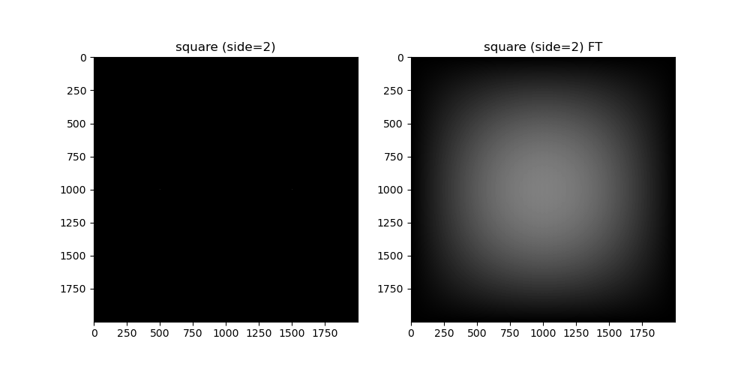
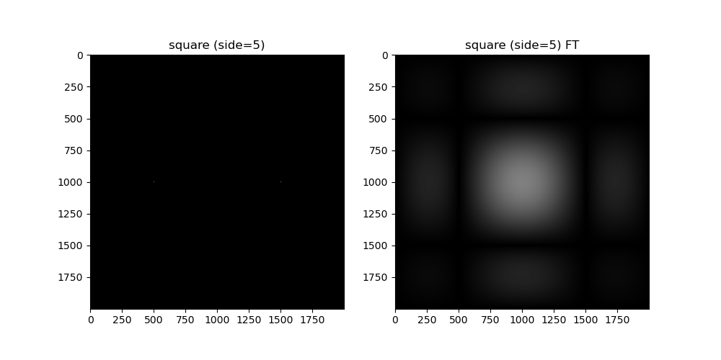
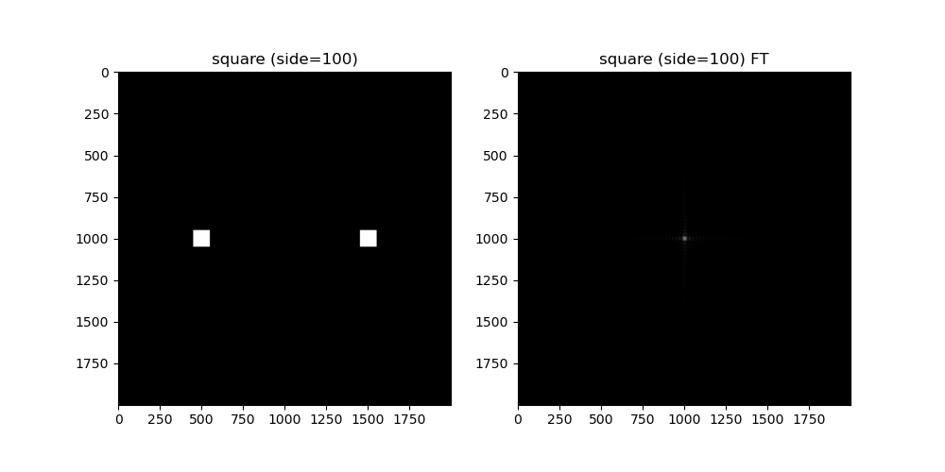
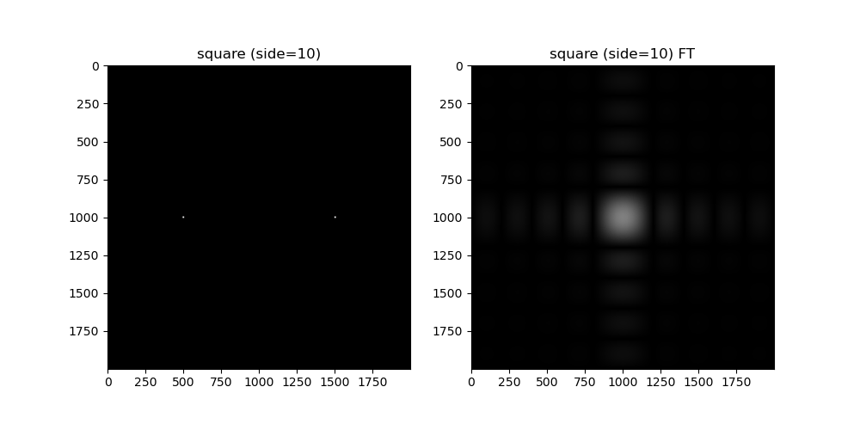
CONVOLUTION THEOREM REDUX
Codes and files: https://github.com/genvert/AP_157_FX-2_Vertudez/tree/main/Activity%202%20Part%202

Slide 11
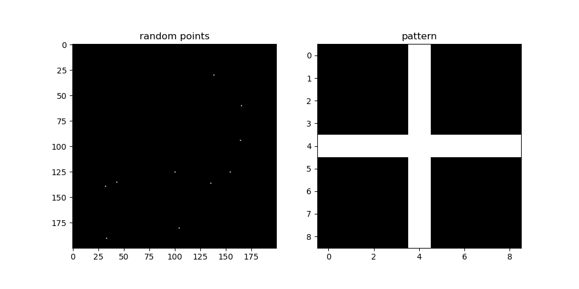
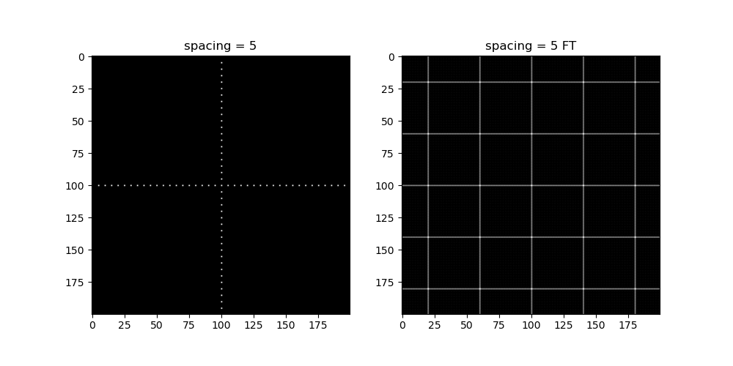

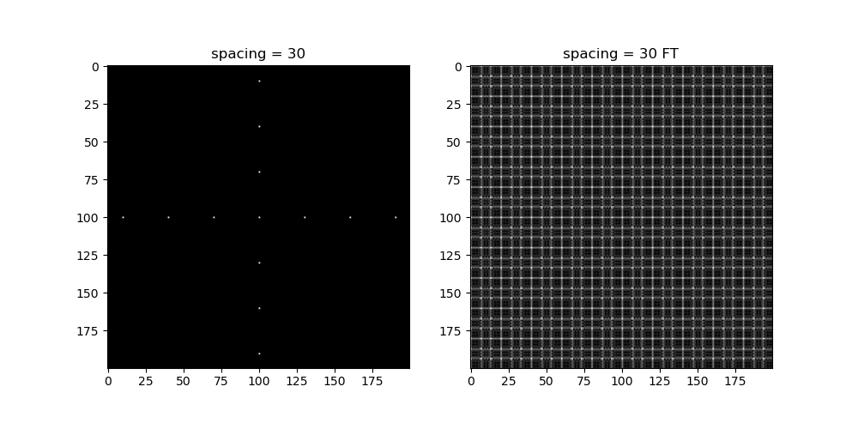
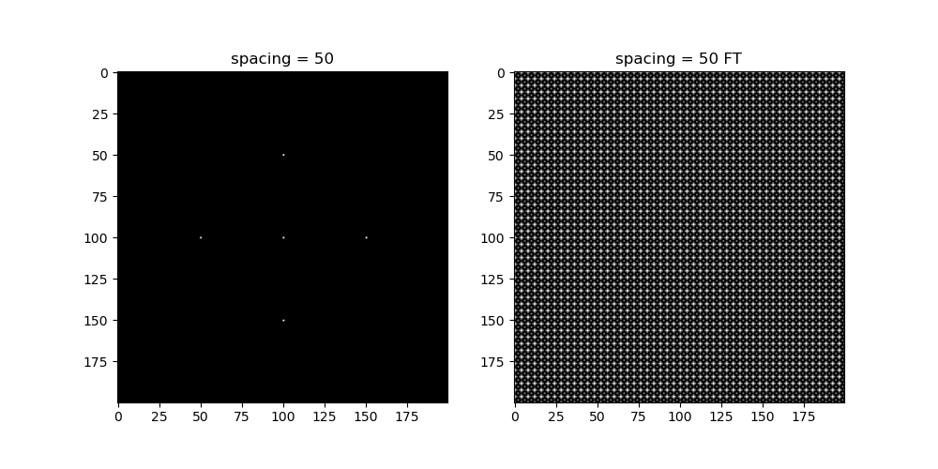
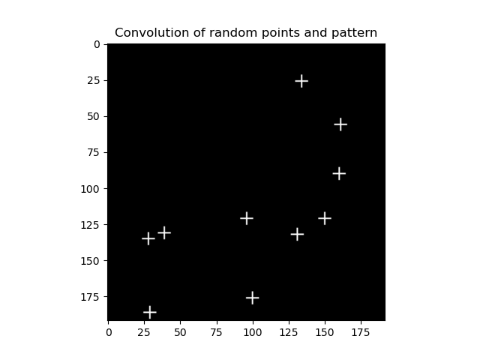
CONVOLUTION THEOREM REDUX
Codes and files: https://github.com/genvert/AP_157_FX-2_Vertudez/tree/main/Activity%202%20Part%202

Slide 12
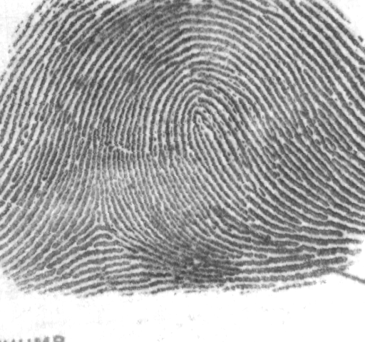

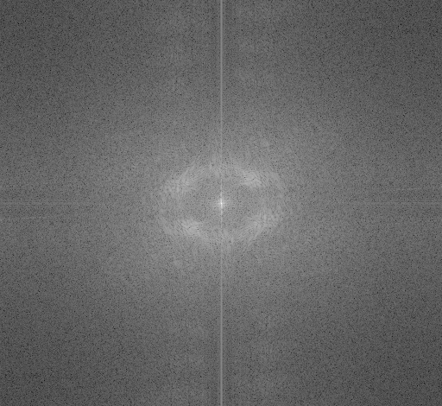
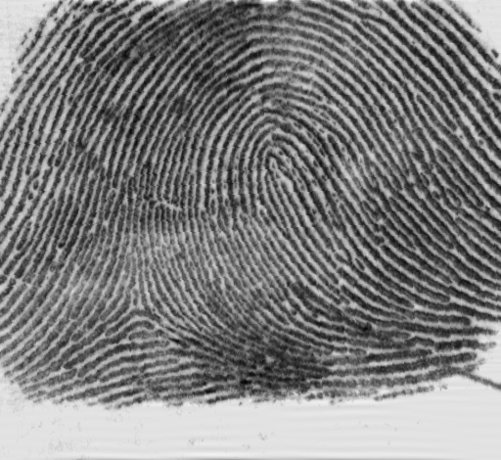
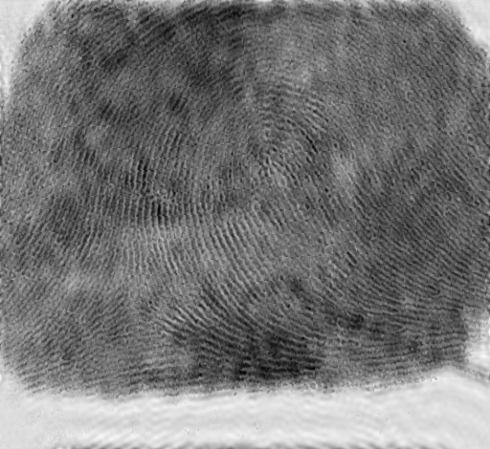
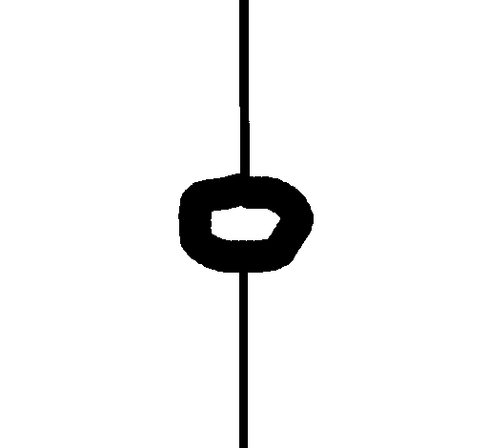
FINGERPRINT: RIDGE ENHANCEMENT
Codes and files: https://github.com/genvert/AP_157_FX-2_Vertudez/tree/main/Activity%202%20Part%202

Slide 13
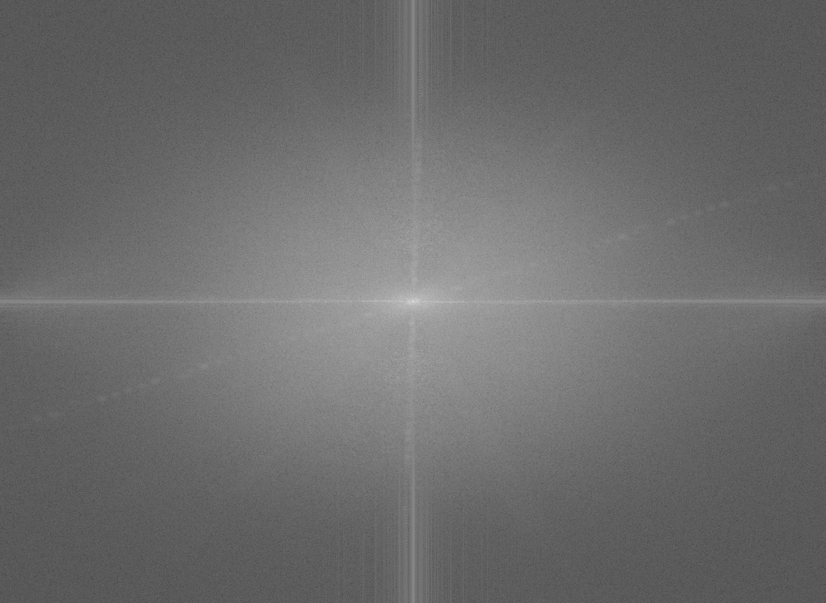
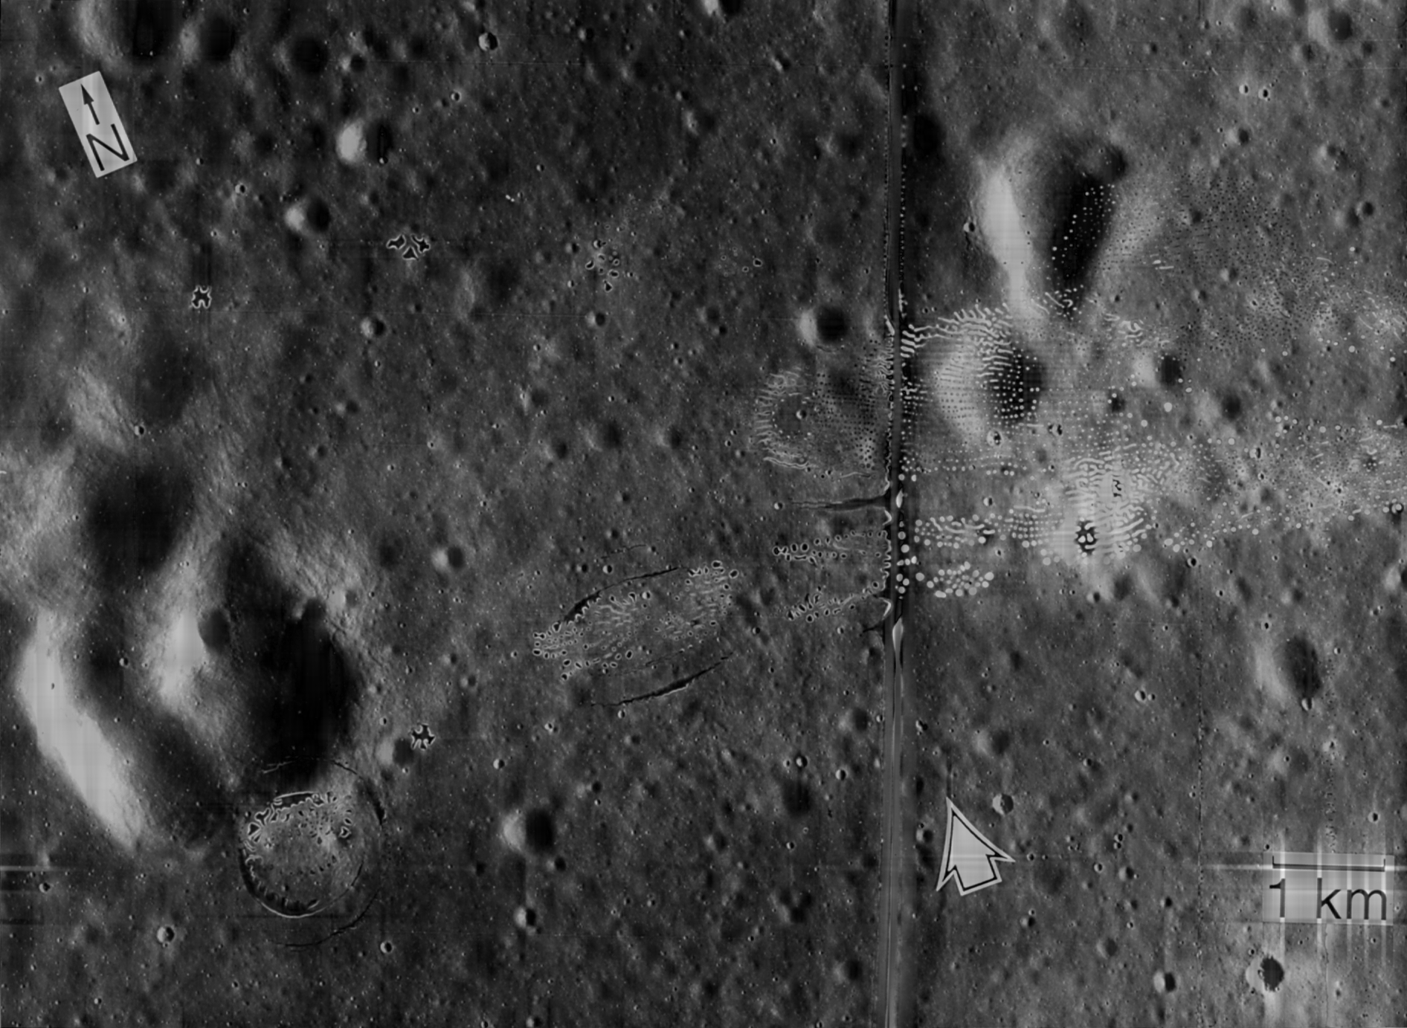

LUNAR LANDING SCANNED PICTURE: LINE REMOVAL
Codes and files: https://github.com/genvert/AP_157_FX-2_Vertudez/tree/main/Activity%202%20Part%202

Slide 14
REFLECTION
This activity was straightforward so I was able to follow it easily.
It is cool that the pixels can act as Dirac delta functions such that other images are copied to each pixel when convolved.
I managed to do it on time this time.

Slide 15
SELF-GRADE
Technical correctness: 35/35
I am confident that I understood how to use ImageJ to extract feature from images, and have applied it.
Quality of presentation: 35/35
I have explained each step, and images are clear and concise.
Self-reflection: 30/30
Even though I was slacking in this subject for a while, I managed to get back on track. The topics are really fun and interesting. It helped me understand the ideas behind image tools such as smartphone cameras, Photoshop, etc.
Initiative: 10/10
I used an extra image for extraction.

